Slide 1
Face detection and recognition
In a group image
Group Number:23
1.Bhagyashree 1PE13EC024
2.Chethan Kumar TJ 1PE13EC031
3.Dhanush M Kuber 1PE12EC041
4.Mridula C 1PE13EC076
Guide: Dr. Subhash kulkarni
24/11/16

Slide 2




DESIGN FLOW WITH TIMELINE
Data base building
Literature collection
Pre processing
15/10/16
Face detection
15/12/16
Feature set
Building and
Recognition
1/1/17
Demonstration
And compilation
15/4/17
Android enabled
App building
15/3/17
Integration
and Testing
15/2/17
24/11/16

Slide 3
TOOLS USED
SOFTWARE
MATLAB R2012a, R2016a(COMPUTER VISION TOOLBOX)
2) OPEN CV-PYTHON V2.4.13
3) ECLIPSE-IDE (ANDROID APP DEVELOPMENT)
4)Appery.jo (CLOUD BASED APP DEVPT PLATFORM)
HARDWARE
1) CAPTURING DEVICE – CAMERA WITH 13MP RESOLUTION
HAS BEEN USED
24/11/16

Slide 4
SKIN DETECTION OVERVIEW
Skin detection is the process of finding skin colored pixels and regions in an image or video.
Given a trained skin detector, identifying skin pixels in a given image or video frame involves:
Converting the image into the same color space that was used in the training phase.
Classifying each pixel using the skin classifier to either a skin or non-skin.
Typically post processing is needed using morphology to impose spatial homogeneity on the detected regions.
24/11/16

Slide 5
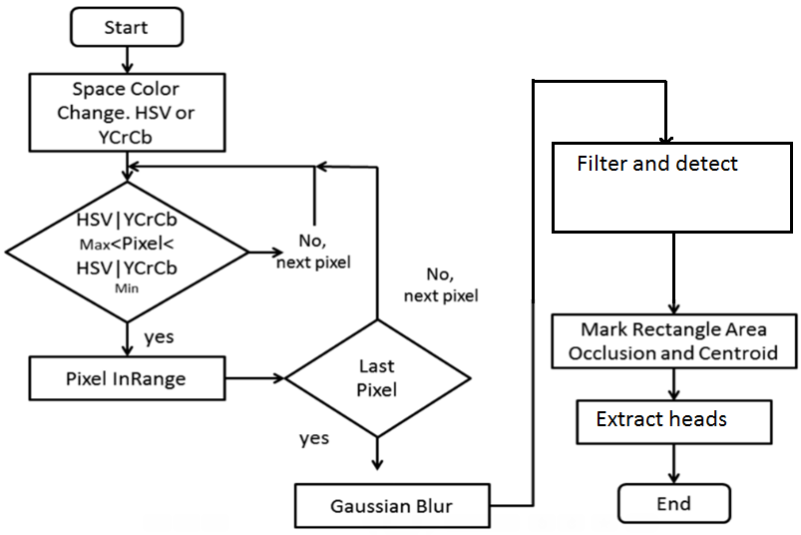
Flowchart for skin detection:
24/11/16

Slide 6
VIOLA AND JONES
Viola jones flowchart
Haar features selection
Input image with face region
Creating an integral image
Adaboost training
Cascading classifiers
Detected face
regions
24/11/16
A sample title

Slide 7
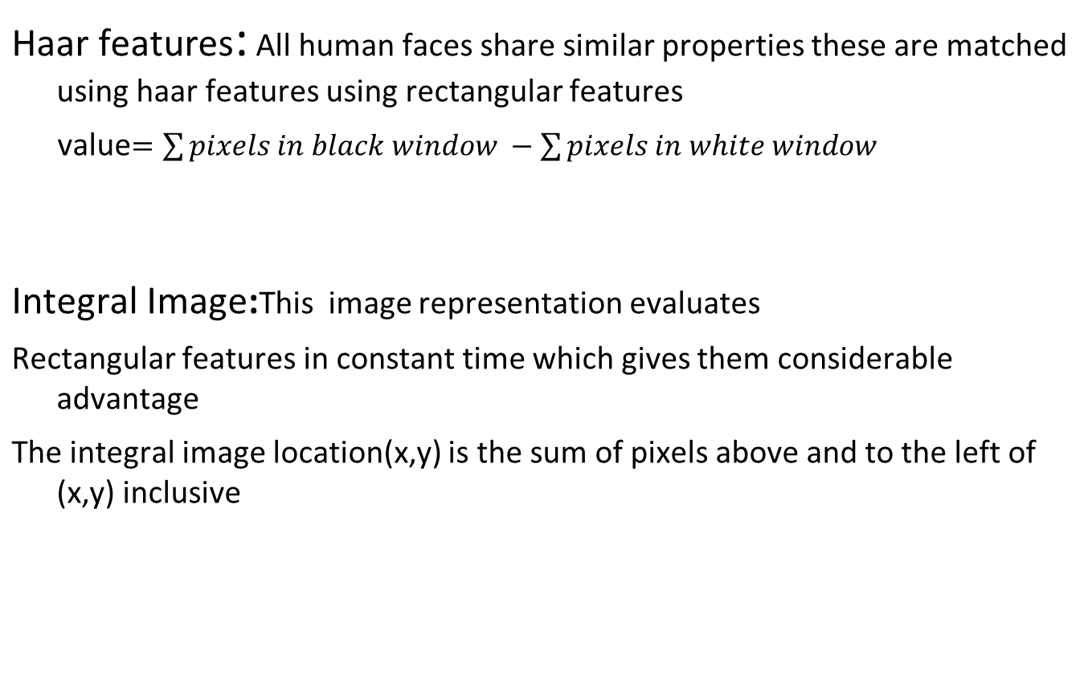
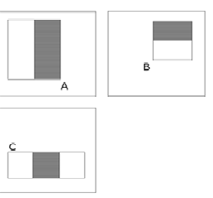

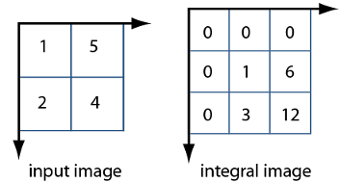
24/11/16

Slide 8
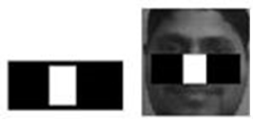
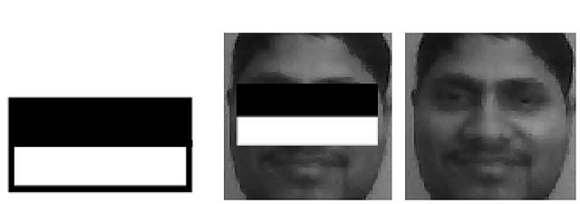
AdaBoost training:
Given a feature set and a training set of positive and negative images any number of machine learning approaches can be used for classification
AdaBoost algorithm is used both to select features and to train the classifier
In original form it is used to boost the classification performance of a simple algorithm
This algorithm constructs strong classifiers as a function of weak classifiers
24/11/16

Slide 9
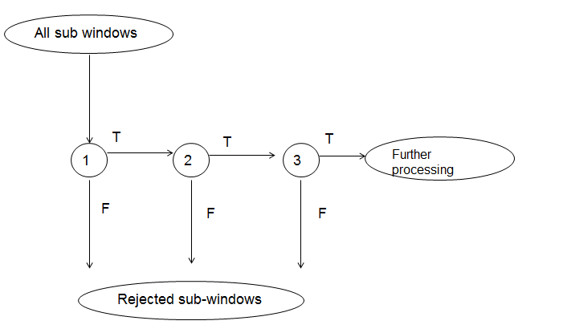
Cascading features: On average only 0.01% of all sub-windows are positive (faces)
Equal computation time is spent on all sub-windows
Must spend most time only on potentially positive sub-windows.
A simple 2-feature classifier can achieve almost 100% detection rate with 50% FP rate.
That classifier can act as a 1st layer of a series to filter out most negative windows
24/11/16

Slide 10
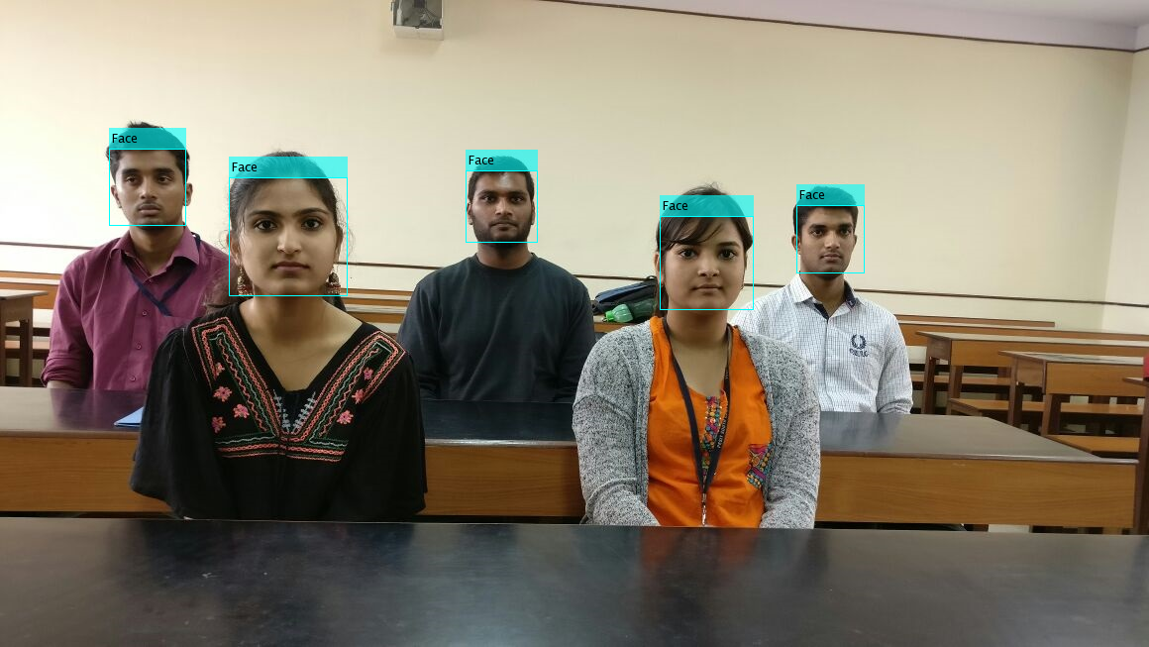
Group Image
24/11/16

Slide 11
Disadvantages of Skin detection
→Not so efficient on different human races and with background
similar to skin colour.
→Skin colour detection is highly affected by the intensity of light
→It is dynamic , the threshold values have to be updated depending on the image
Advantages of Viola–Jones algorithm
→High accuracy and efficient feature selection
→Scale and location invariant detector
→Instead of scaling the image itself (e.g. pyramid-filters), we scale the features.
→Such a generic detection scheme can be trained for detection of other types of objects.
24/11/16

Slide 12
REFERENCES
1) Skin Detection - a Short Tutorial † Ahmed Elgammal, Crystal Muang and Dunxu Hu Department of Computer Science, Rutgers University, Piscataway, NJ, 08902, USA
2) Detection & Selection of Skin and Skin like background under Complex Background
Sangita Gudadhe1, Priti Subramanium2
1,2Department of Computer Science & Engg, SSGBCO, E&T, Bhusawal, India
Robust real time object detection,IJCV 2001: Viola,Jones
Eigenface-based facial recognition 2002, Dimitri PISSARENKO
24/11/16

Slide 13
THE END
24/11/16

